Slide 1



OTP Finds a way
FOSDEM 2026 Jonas Lindström
decerno.se

Slide 2

Jonas Lindstrom
Public transportation for 25 years
Decerno
Swedens first OTP installation at Skånetrafiken

Slide 3

OTP
Open Tripplanner is an multimodal trip planner
Launched in 2009
Java application

Slide 4
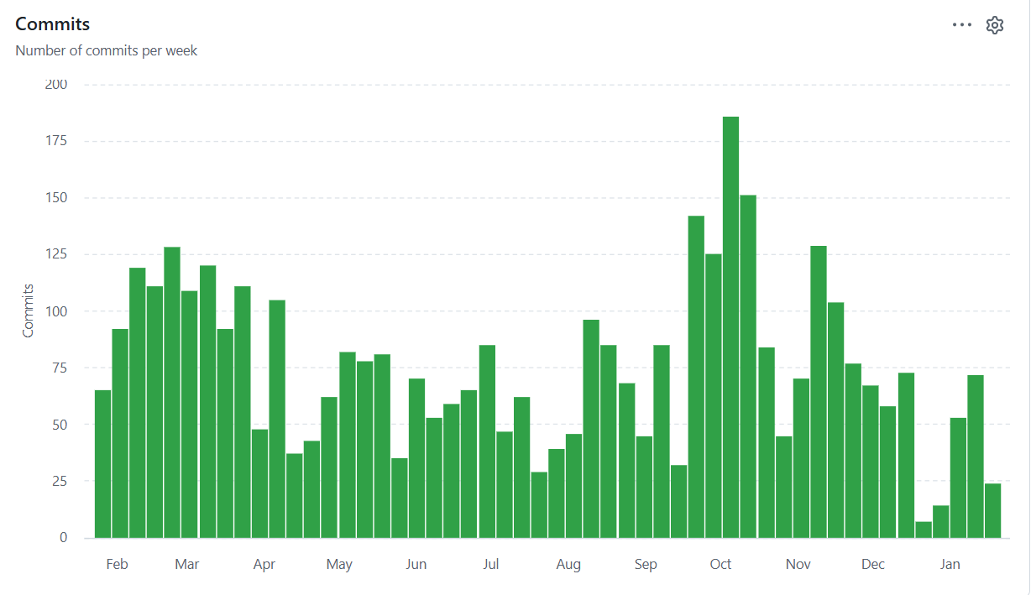
Community
https://github.com/opentripplanner
Active forum (gitter room)

Slide 5

Data
OTP can handle data on a number of formats.
Timetable data: NeTEx, GTFS
Realtime data: Siri-ET, Siri-SX, GTFS-RT
Street/walk data: OSM

Slide 6
Search in numbers
8000
1,1M
100-300
Stops
Addresses
Realtime updates/sec
300
1M
Queries/sec
Queries/day

Slide 7
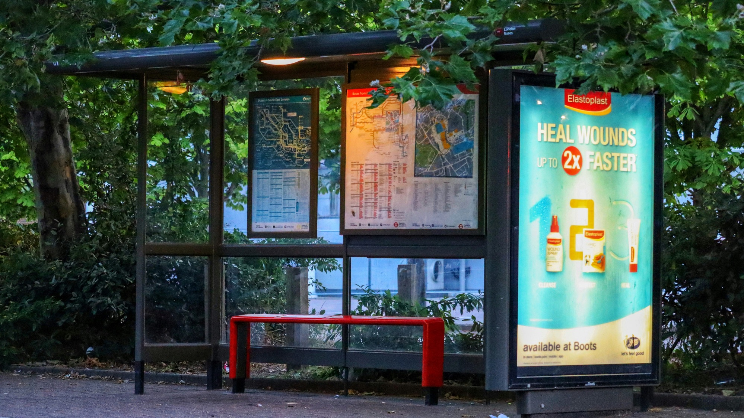
Timetable
Planned timetable data is the backbone

Slide 8
OTP FINDS A WAY - JONAS LINDSTRÖM
Routing
Timetable
Routing between walk, bus, train, ferry is at the core of OTP functionality

Slide 9

Realtime Routing
*A transfer might not be possible with updates in arrival/departure time

Slide 10
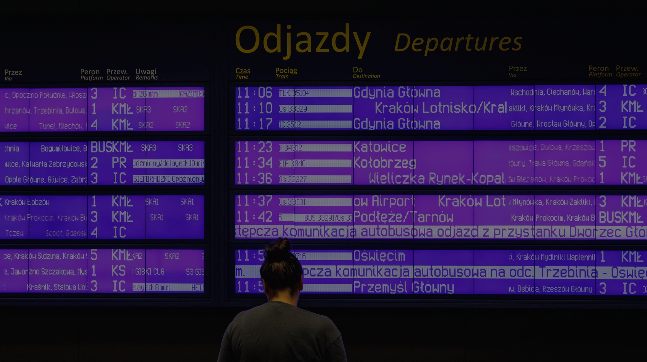
Cancellations and delays

Slide 11
Weather…
A missed connection can be serious

Slide 12

Accessibility
*Able to route trips that are accessible with wheelchair

Slide 13

Timetravelling train
*Different requirements from systems
*Conflicting businessrules

Slide 14

Ghost bus
*Missing realtime data
*Old realtime data

Slide 15
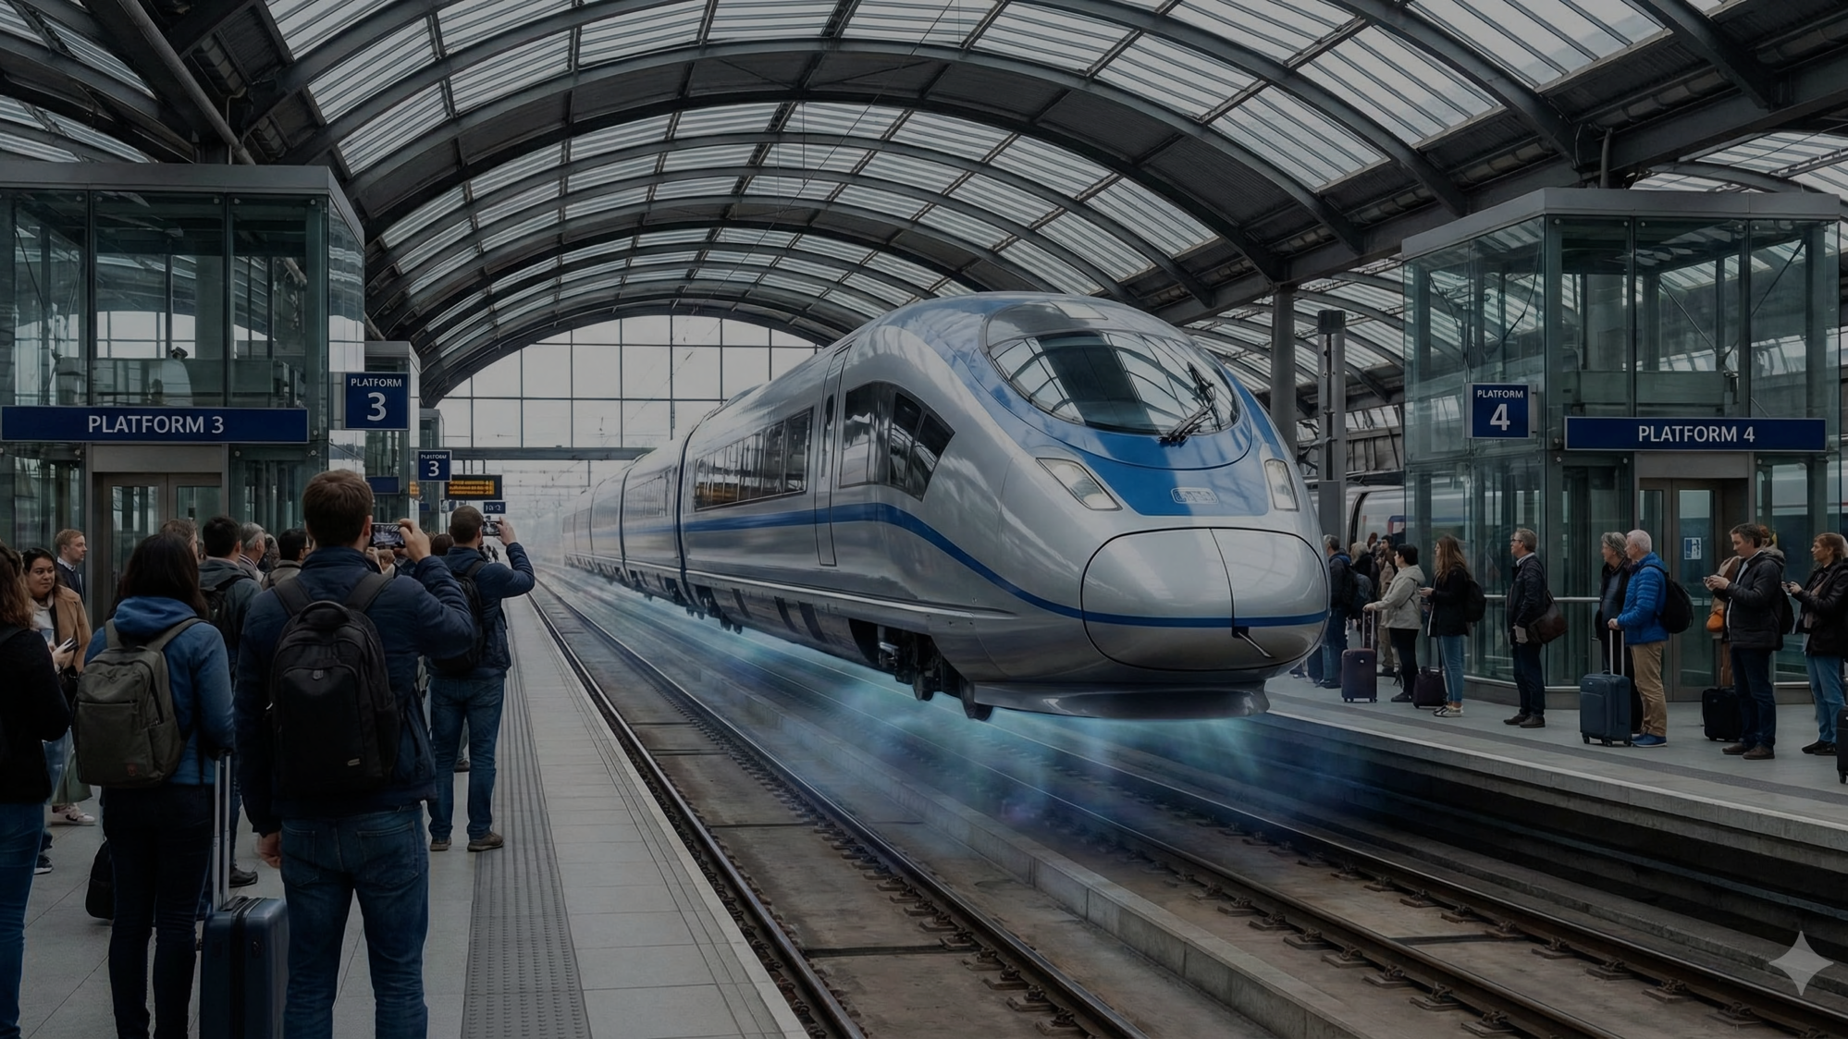
Platform change
*Understanding realworld events
mapped in data

Slide 16
Map data
*OpenStreetmap provides 2M streetsegments/paths use to route walk

Slide 17

Map data
*Stops not connected to walkable network can only be reached by bus/train

Slide 18
Stairs
3
2
*Routing walk via stairs comes with a penalty
*Also penelty for roadcrossings, paths shared with biked, etc
1

Slide 19


Slide 20

Jonas Lindström
Thanks!
jonas.lindstrom@decerno.se
Questions?
LinkedIn

